Slide 1
Big Mountain Resort
How to maintain or increase annual revenues and our 9.2% profit margin?

Slide 2
Problem Identification
Additional chair lift - increases operating costs by $1,540,000 this season
Recoup increased operating costs from new chair, ski season 2021
Maintain or increase annual revenues and 9.2% profit margin

Slide 3
Criteria for Success
Operating costs reduced/income increased by $1,540,000
Maintain/increase 9.2% profit margin
No later than end of ski season 2021

Slide 4
Recommendation and Key Findings
Big Mountain currently charges $81 a ticket
Analysis of other mountains with similar amenities
Appropriate price = $95.87… ~$26 million additional revenue
$85.48 range between -$106.26
GREAT NEWS!!
New chairlift expenses can be neutralized by 88 cent increase in ticket price
Cost Reduction Scenarios
Scenario 1: closing 2-6 runs
Scenario 2: adding a run, increasing the vertical drop by 150 feet, and installing an additional chair lift
Both increases support for ticket price by $1.45 Over the season = $2,545,455
Other scenarios no savings

Slide 5
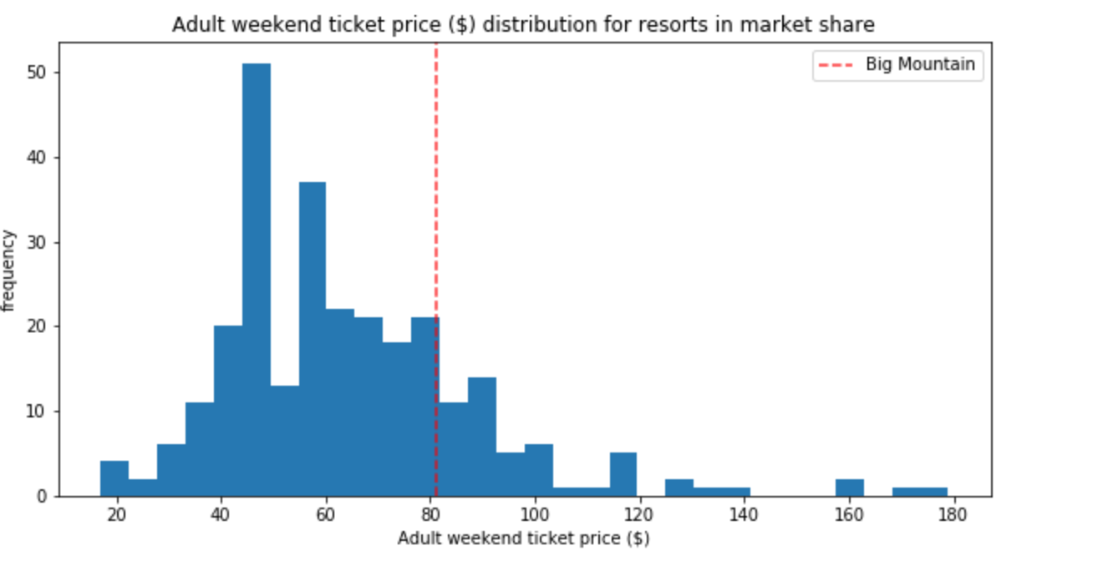
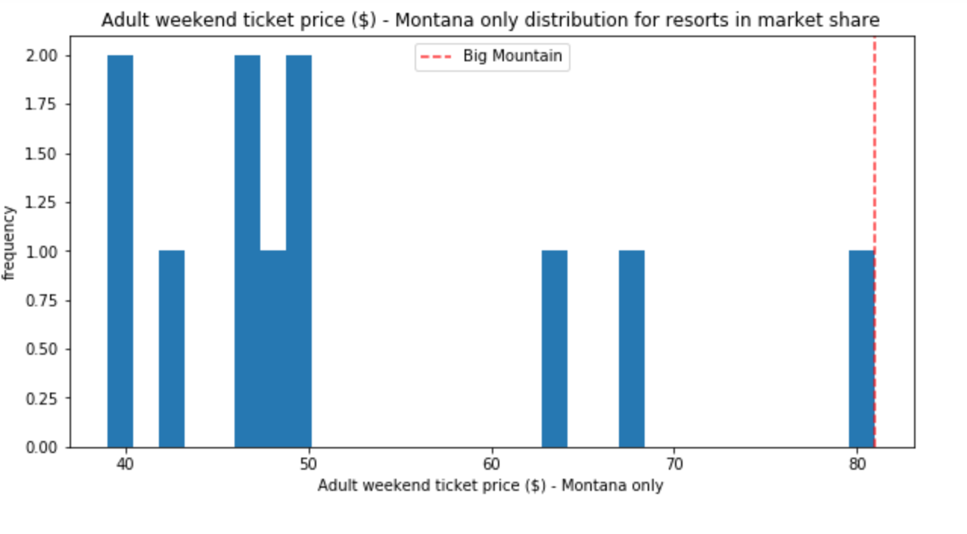
Modeling Results & Analysis
Notes:
Look at where Big Mountain sits overall amongst all resorts for price and for just other resorts in Montana. Seems higher end right?? But...

Slide 6
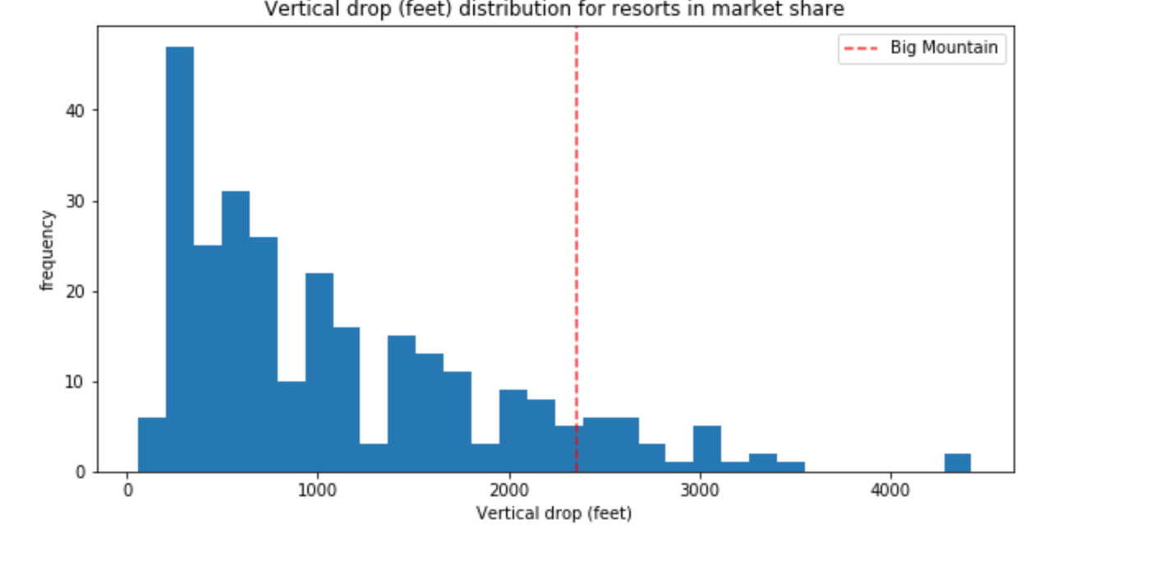
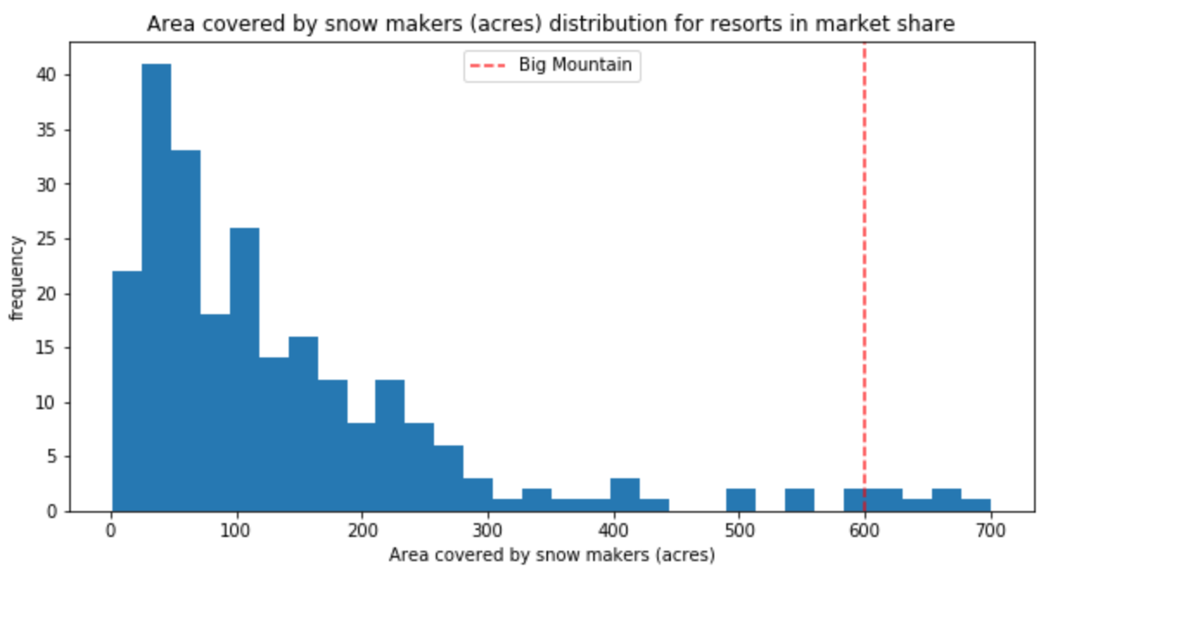
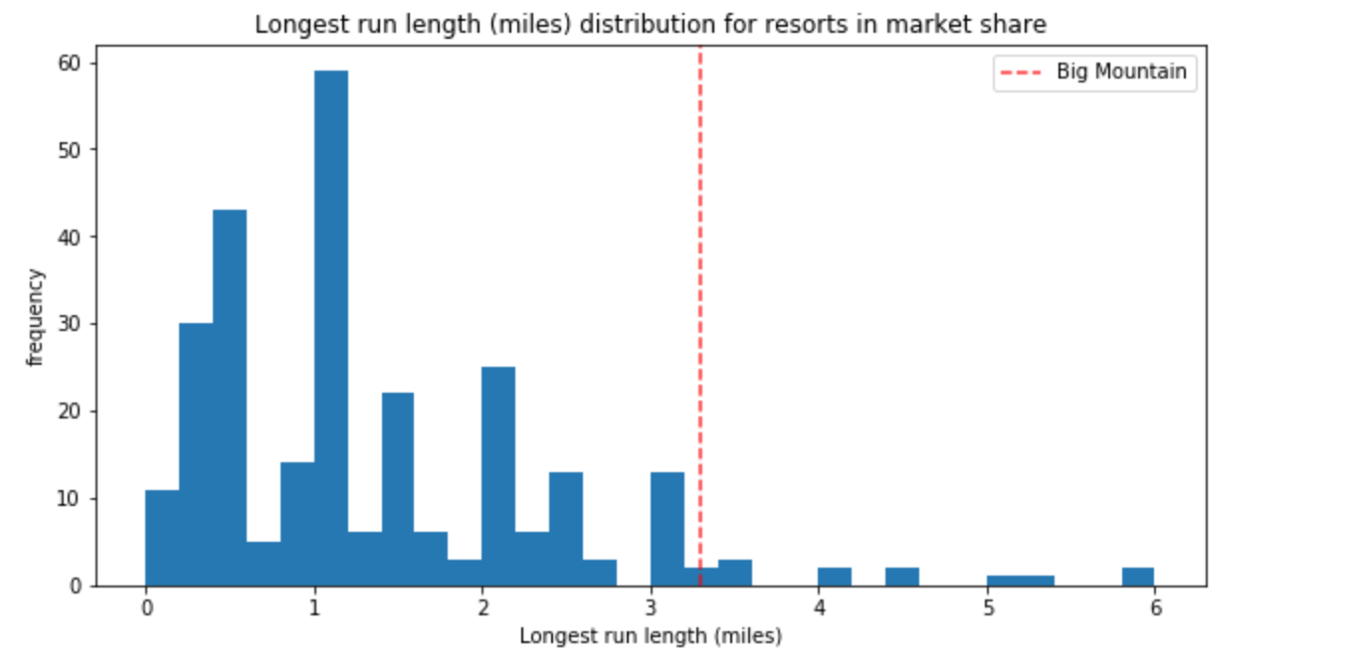
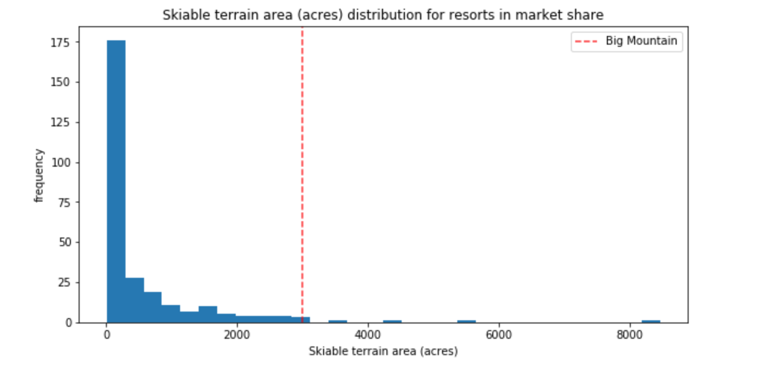
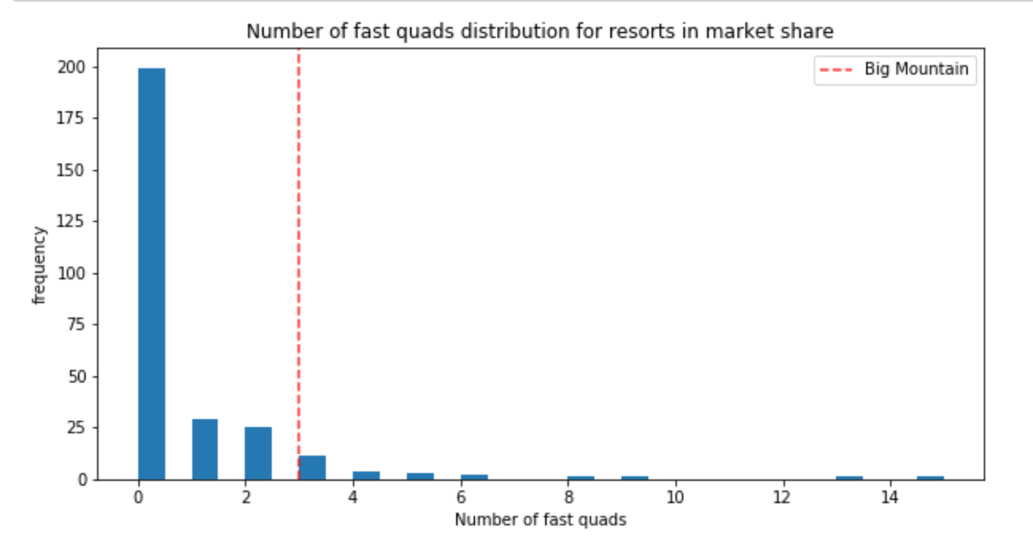
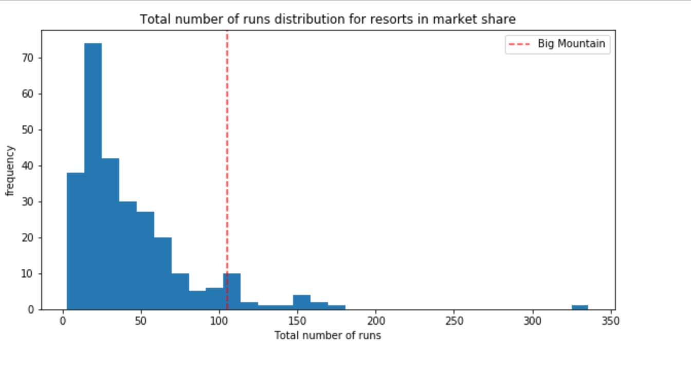
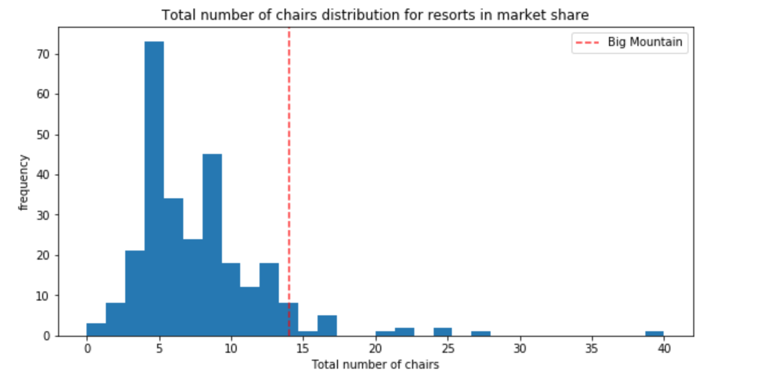
Notes:
Big Mountain consistently in top tier for Key metrics that determine ticket price:
Vertical drop
Snow making area
Total number of chairs
Runs
Longest Run
Trams
Skiable Terrain Area

Slide 7
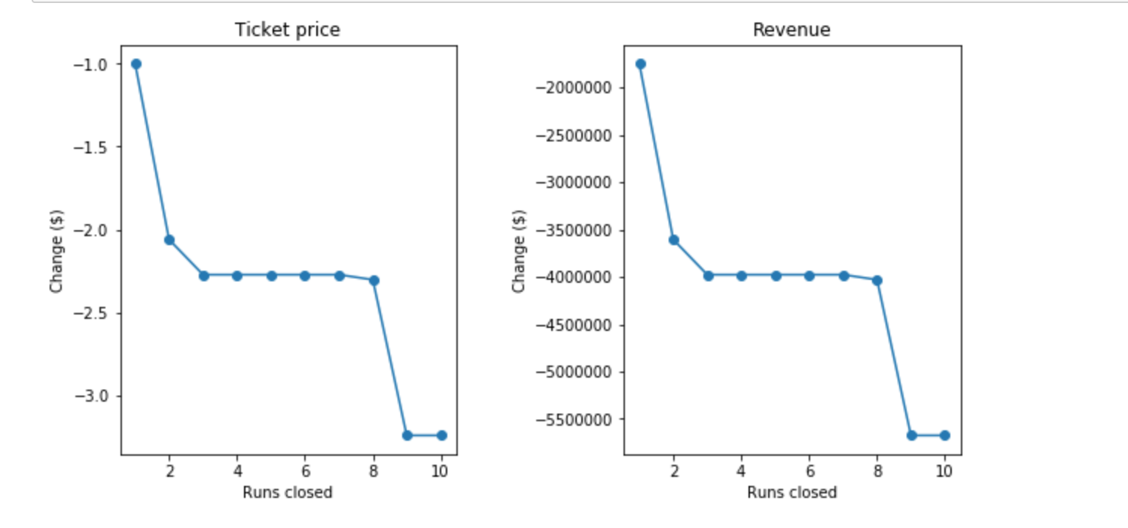
Cost Reduction Scenario 1&2
Notes:
The model says closing one run makes no difference. Closing 2 and 3 successively reduces support for ticket price and so revenue. If Big Mountain closes down 3 runs, it seems they may as well close down 4 or 5 as there's no further loss in ticket price. Increasing the closures down to 6 or more leads to a large drop.
Scenario 2 - This scenario increases support for ticket price by $1.45
Over the season, this could be expected to amount to $2545455

Slide 8
Summary and Conclusions
Increase Income
Increasing ticket price to $81.88 will cover the new ski lift
Could also increase ticket price to $85.48 - $106.26 to be in line with competitors with similar amenities
$95.87 = ~$26 million additional
Cost Reduction
Closing runs will come at a cost, depending on cost may be worth it for 2-6 runs
Adding a run, increasing the vertical drop by 150 feet, and installing an additional chair lift, could increase ticket price by additional $1.45
Model could be used for future analysis
Notes:
Both increases support for ticket price by $1.45 Over the season = $2,545,455

